Slide 1
White Nose Syndrome Decontamination Tips and Tricks NSS Convention 2016 Jennifer Foote, NSS WNS Liaison
Special thanks to Rickard Toomey and Knutt Peterson

Slide 2
USFWS New Decon Policy issued in April 2016
https://www.whitenosesyndrome.org/topics/decontamination
It may be updated again.
7 pages: Intro, purpose, product use, trip planning/organization, procedures for decontamination, equipment and activity specific recommendations
Reading it is good, but just knowing the basics is okay…

Slide 3
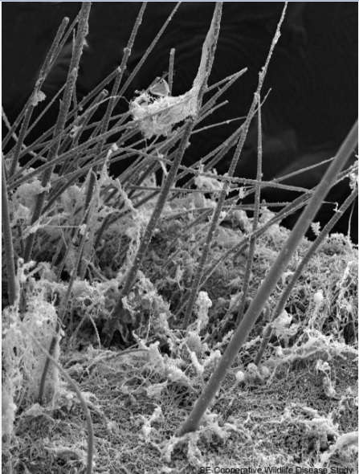
WHY- Fungus persists in the environment
Fungus sometimes detected 3 years before visible signs present/mass mortality.
Cave/mine soils are a reservoir for the fungus and bats seem to pick it up again in fall from the infected roosts.
Cave gear can pick up the fungus even without bats present and theoretically be a method of transport.
Insert photo fungus

Slide 4
It is still unknown where it came from and HOW it got here.
50% of approximately 250 caves sampled in Europe were positive for the fungus. Some caves may remain an uninfected refuge in a “saturated” area.
Rates of detection from substrate vary, especially without bats present. So even if a cave has been tested, it might be positive.
European version has two mating types, so far North American version is clonal. Don’t want to mix these regional types.

Slide 5
Cavers Care
Risk management includes controlling what we can, and there is not much we can do.
The policy is: no movement of potentially infected gear from an infected area to a clean one. EVEN if DECONTAMINATED.

Slide 6
When do you have to decon?
Policies vary
In general, should decontaminate between each cave/management area.
Depends on cave manager. Some agencies group caves for ease of decontamination purposes.
Even in saturated areas, we need to clean our gear for other future pathogens and other biota.

Slide 7
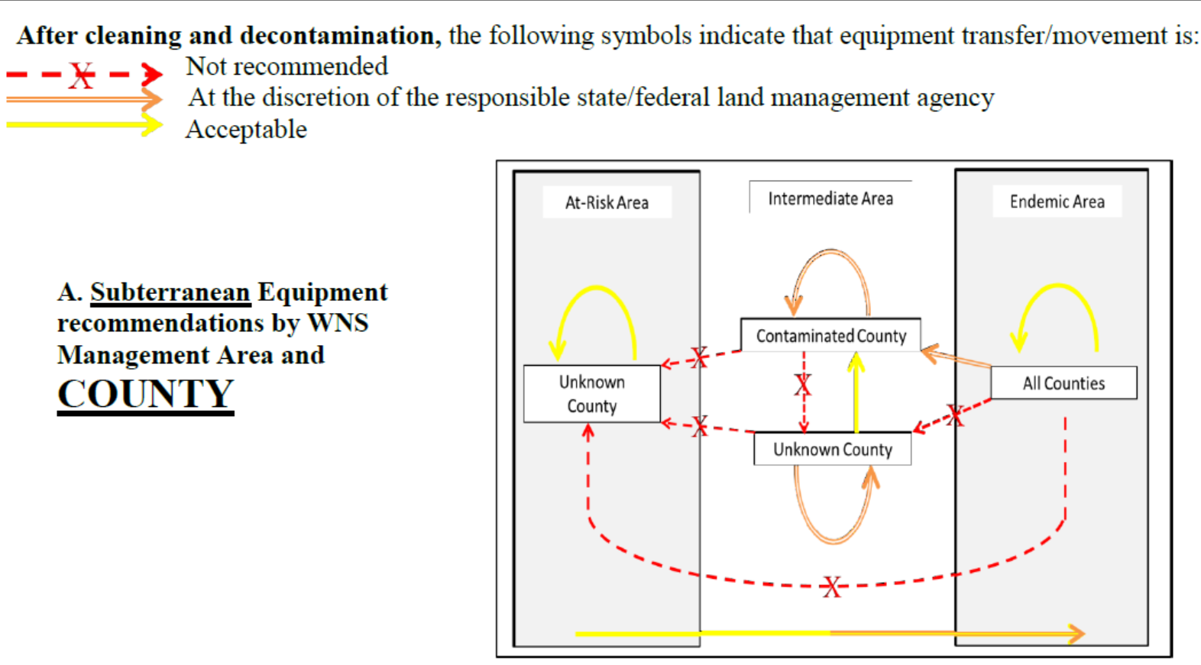
Where
Basics= don’t bring potentially infected gear to a clean place.
Notes:
For WNS = 3 zones: endemic/infected, intermediate, and at-risk/clean.
Goal: reduce the risk of human assisted spread

Slide 8
Just clean your gear!
and
Don’t transport gear out of region!

Slide 9
HOW
#1 preferred method - keep designated gear for a cave/area and no decon is needed
#2 preferred method is hot water
#3 method- chemicals

Slide 10
Planning
Pretrip –minimize gear, bag emergency gear so it stays “sealed” and doesn’t need decon.
Plan how to containerize gear when get out. Have the trashbag/box, clean clothes and wipes near the door of the car.
If having several sets of gear is not possible for individuals, consider grottos or projects purchasing dedicated loaner gear.

Slide 11
131 for 20

Slide 12
After containment and mud removal !

Slide 13
60% ethanol (120 proof)

Slide 14
Ethanol
Keep wet for one minute

Slide 15
70 % isopropanol/isopropyl wipes, instant

Slide 16
For nonporous objects -Read the label

Slide 17
Washing yourself, soap and water ok

Slide 18
Precleaning- Decontamination does not work through mud. Wash clothes before deconning or mud may set. Toothbrush for cameras

Slide 19
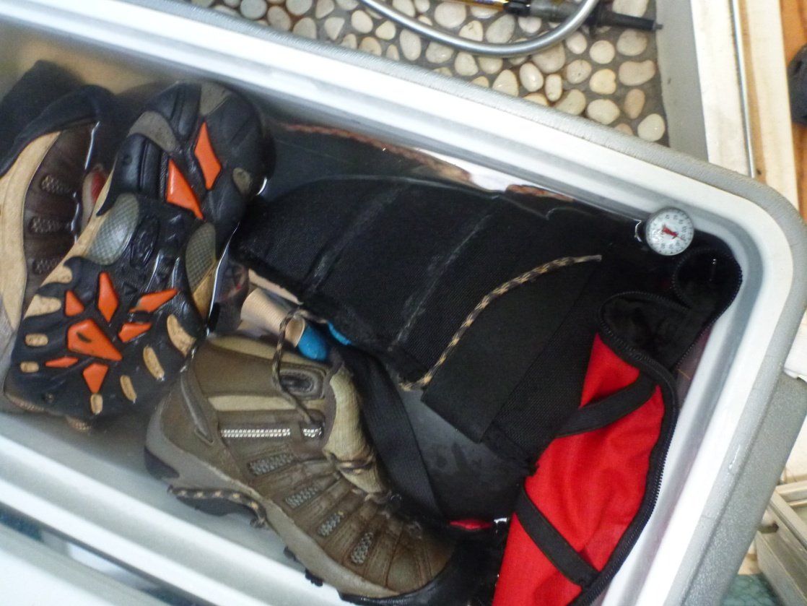
Hot water
Coolers for home use.

Slide 20
Potential for use of residential dishwashers and washing machines in WNS decontamination, Rickard S. Toomey III Mammoth Cave International Center for Science and Learning, Western Kentucky University and Mammoth Cave National Park

Slide 21
Potential for use of residential dishwashers and washing machines in WNS decontamination, Rickard S. Toomey III Mammoth Cave International Center for Science and Learning, Western Kentucky University and Mammoth Cave National Park

Slide 22
Group Events-Make it easy with a Decon Station

Slide 23
BLM and Fort Stanton Cave Study Project Recirculates water with on demand water heater and cattle tank
Notes:
Contact knuttpet@blm.gov for design info until future NSS News article.

Slide 24
Propane burners and big pots

Slide 25
Signage can be helpful for large groups
Notes:
Set up information for

Slide 27
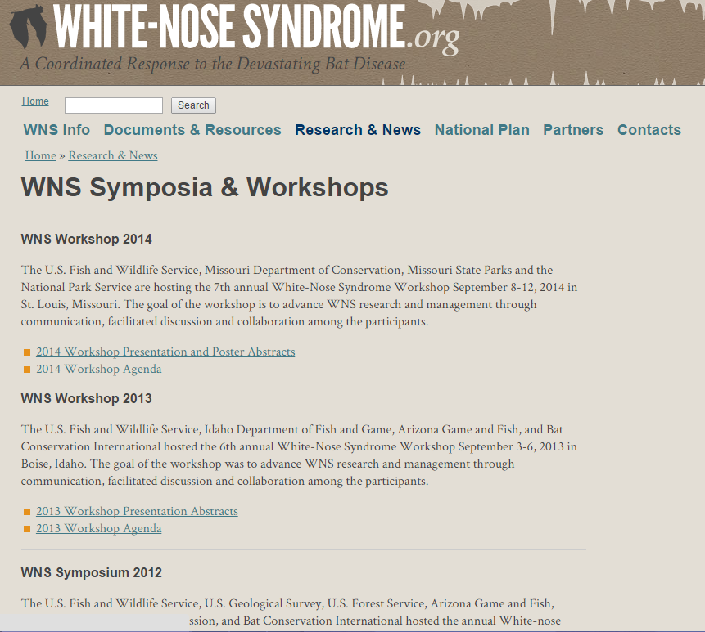
Where to find more info
www.whitenosesyndrome.org

Slide 28
www.caves.org/WNS
Contact WNSLiaison@caves.org
email list http://lists.caves.org/mailman/listinfo/wns
We explore, we study, we protect. Visit www.caves.org.

